Slide 1
Game Design

Slide 2
What is Game Design?
According to Brathwaite and Schreiber in Challenges for Game Designers:
Game design is the process of creating the content and rules of a game.
Good game design is the process of creating goals that a player feels motivated to reach and rules that a player must follow as he makes making meaningful decisions in pursuit of those goals.

Slide 3
Bartok: A Game Design Exercise
Bartok is a classic card game that is similar to the commercial game Uno.
All you need to play are three to five players and a standard deck of playing cards:
Break into groups of 3-5 players each.
Remove the Jokers from the deck.
Shuffle the cards.

Slide 4
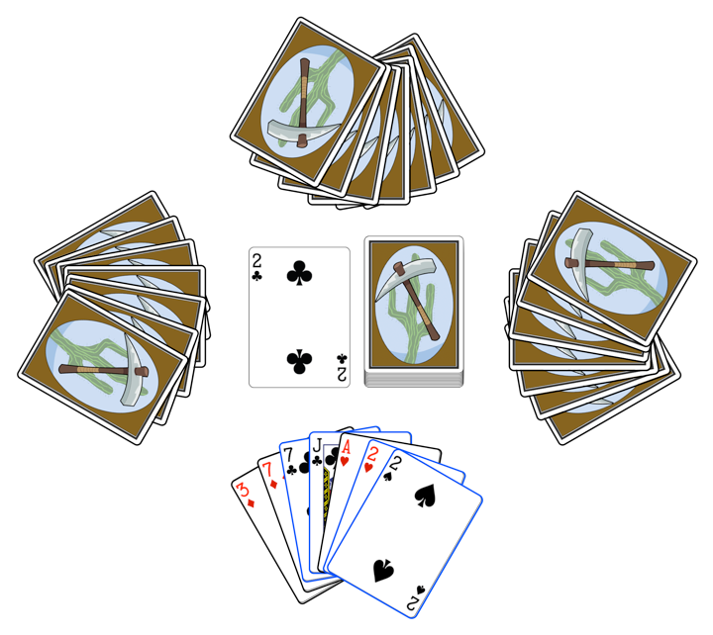
Bartok: Rules
Objective
Be the first person to run out of cards.
Standard Rules:
Deal 5 cards to each player. (The remaining cards become a draw pile.)
Flip over the top card of the draw pile to start a discard pile.
The person to the left of the dealer plays first, and play proceeds clockwise.
Each player must play a card onto the discard pile that matches the suit or number of the top card of the discard pile.
If she can’t, she must draw a card.
If the draw pile is empty, reshuffle the discard pile and replace as the draw pile.
The player can choose to play any one of the cards highlighted with blue borders (7C, JC, 2H, 2S).

Slide 5
Bartok: Analysis
Is the game of the appropriate difficulty for you and your group?
Is the game of the appropriate difficulty for all groups?
Is the outcome of the game based more on strategy or chance?
Does the game have meaningful, interesting decisions?
Is the game interesting when it's not your turn?

Slide 6
Bartok: Modifying the Rules
Roll a d20 % 4 (d20 is a 20-sided die) to determine which rule to add to the game.
Rule 0:
If a player plays a 2, the person to her left must draw two cards instead of playing.
Rule 1:
If any player has a card that matches the number and color (red or black) of the top card, she may announce "Match card!" and play it out of turn. Play then continues with the player to the left of the one who just played the out-of-turn card. This can lead to players having their turns skipped.
Rule 2:
A player must announce “Last card” when she has only one card left. If someone else calls it first, she must draw two cards (bringing her total number of cards to three).
Rule 3:
Add the two jokers to the deck. One-eyed jacks and jokers are wildcards: they can be played at any time on a player's turn.

Slide 7
Beware of Erroreous Conclusions from Sampling
A strange shuffle or other external force can cause one playtest of the game to be very different from others.
You must playtest several times to ensure that you experience an average playtest and not a fluke.
However, you must also note any flukes that happen because they can also happen to players.

Slide 8
Bartok: Modification Questions
How did the single rule change the game?
Have the answers to your questions changed?
Is the game of the appropriate difficulty for you and your group?
Is the game of the appropriate difficulty for all groups?
Is the outcome of the game based more on strategy or chance?
Does the game have meaningful, interesting decisions?
Is the game interesting when it's not your turn?
Changing a single rule can have a drastic affect on the feel of the game!

Slide 9
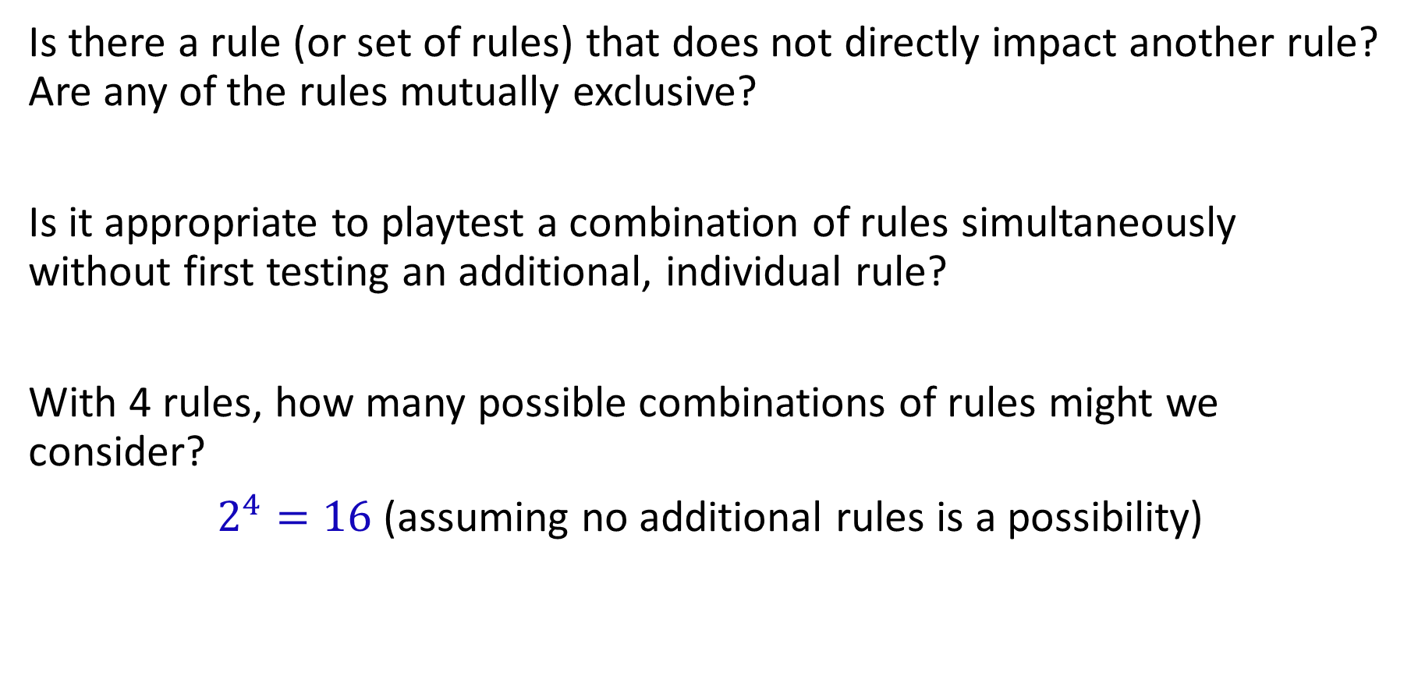
Bartok: Playtesting Questions
Is there a rule (or set of rules) that does not directly impact another rule? Are any of the rules mutually exclusive?
Is it appropriate to playtest a combination of rules simultaneously without first testing an additional, individual rule?
With 4 rules, how many possible combinations of rules might we consider?
$2^{4}=16$ (assuming no additional rules is a possibility)

Slide 10
Bartok: Make Your Own Rules
Ask yourself, how do you want the game of Bartok to feel?
Goal:
Design a rule set to elicit this specific emotion.
Task:
Change one rule at a time. Test with the new rule and see how it feels.
You don't need to complete an entire game if the rule does not feel right. Work with your group to make the game your own.
Recall: Good game design is the process of creating goals that a player feels motivated to reach and rules that a player must follow as he makes making meaningful decisions in pursuit of those goals.

